Slide 1


Cryogenic Cooling of a 3D Printed Cone Model for Hypersonic Wind Tunnel Experimentation
Makena Wheeler
Mentors Dr. Alex Craig & Brian Kinsey
Boundary Layer Stability & Transition Laboratory
University of Arizona
AZSGC Student Research Symposium
April 18-19, 2025

Slide 2
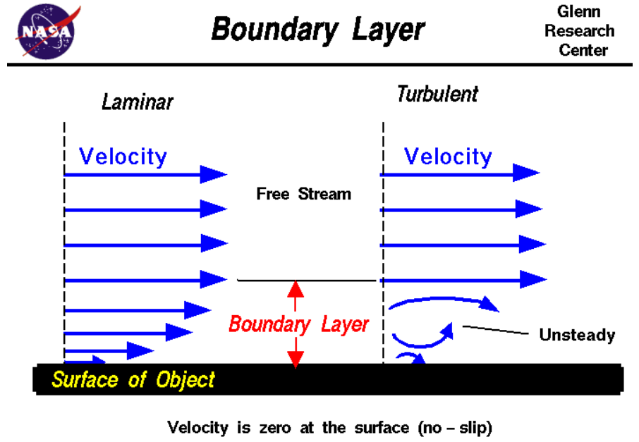
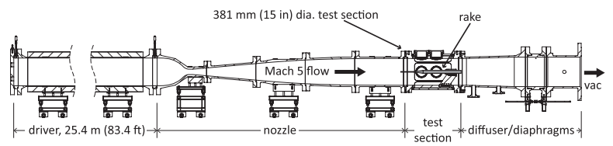
Background – Ludwieg Tubes & Hypersonic Flow
Boundary layers & transition
LT5 at the University of Arizona
Wall to freestream temperature ratio
Flight simulation & 2nd mode instabilities
Fig 1: Boundary Layer Schematic, grc.nasa.gov
Fig 2: LT5 Schematics, Bearden et al. (2022)

Slide 3
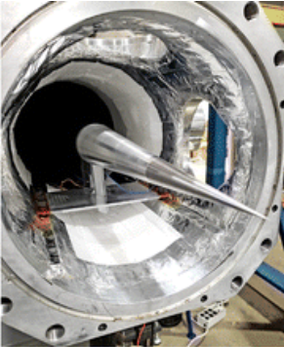
Project Motivations
Easily manufacturable model with cooling capabilities
New attempt at uniform cooling on challenging geometry
Expand knowledge of Formlabs Rigid 10K material
Integrate with LT5 for cooling during tunnel runs
Fig 3: Example of Cooled Cone System in Ludwieg Tube, Paquin et al. (2022)

Slide 4
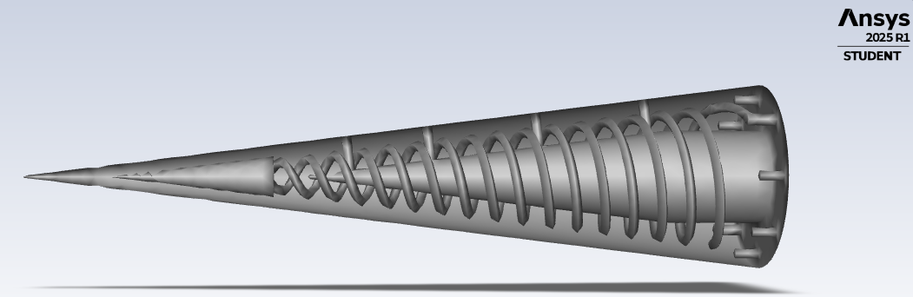
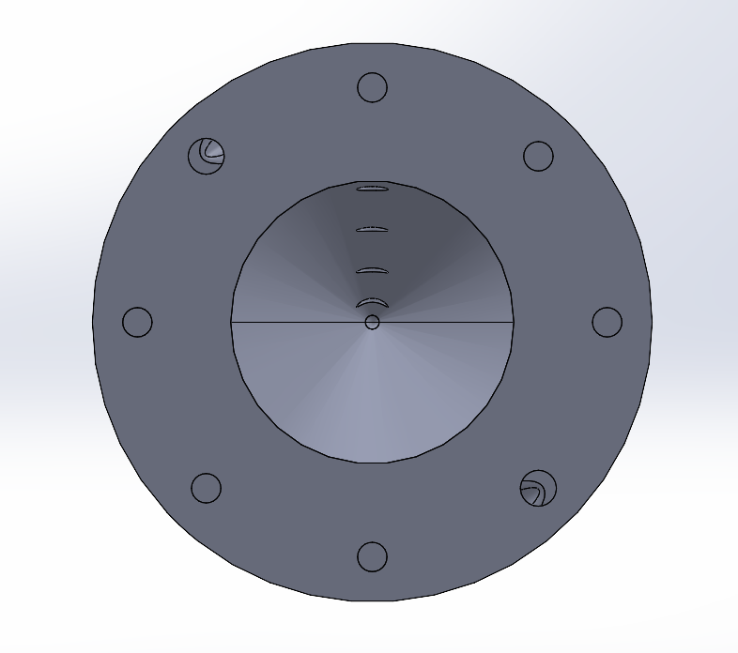
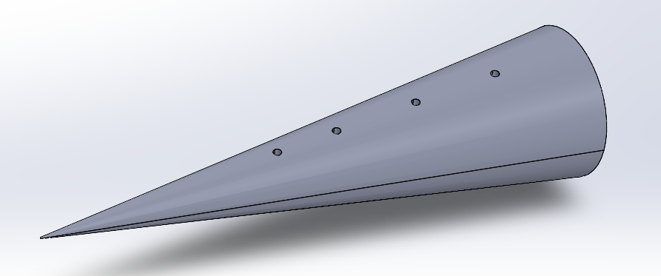
Cooling System Design – Model Geometry
3D printed Rigid 10K
Coiled channels
Circulating tip reservoir
Inlet
Fig 4: Transparent Model View
Outlet
Sensor Installation Holes (x4)
Fig 5: Flow Inlet & Outlet Model View
Fig 6: Isometric Model View

Slide 5
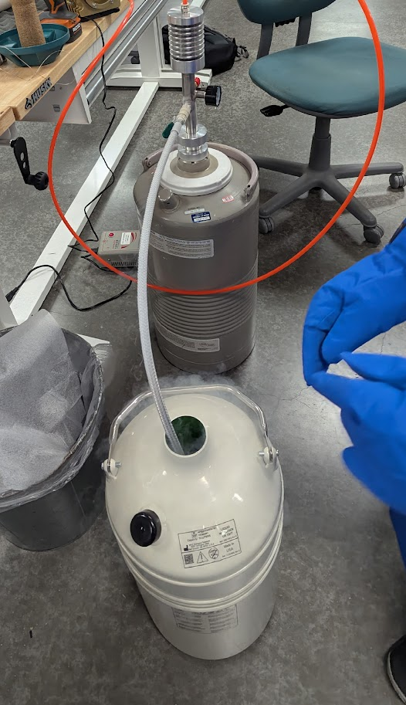
Cooling System Design – Pumping Set Up
Traditional LN2 foot pump connected to an air compressor
Cryogenic steel hoses between dewars
Cryogenic epoxy connecting hoses to model
Flow validation test: 1.67 [L/min]
LN2
air
Compressor
Full Dewar
Model
Empty Dewar
Fig 7: LN2 Bench Test Pumping Set Up
Fig 8: Flow Validation Test

Slide 6
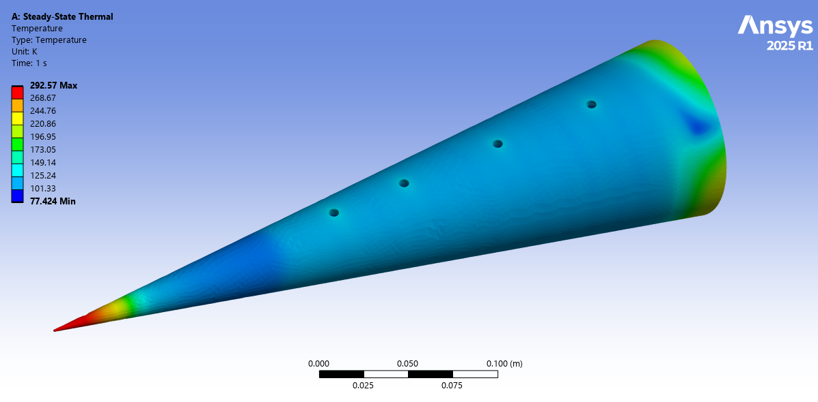
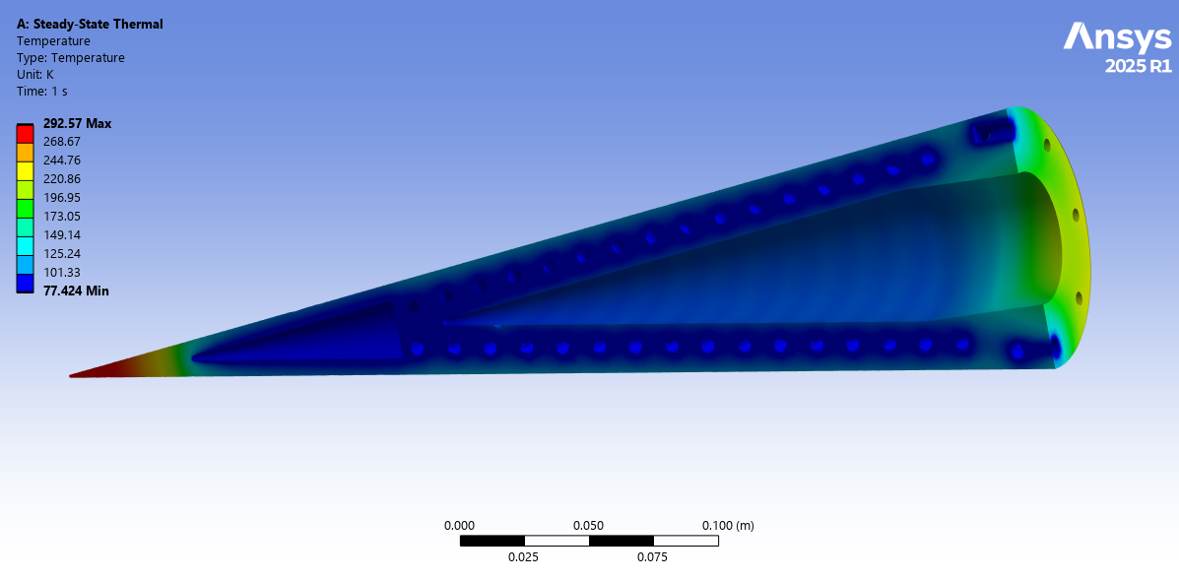
Thermal Simulation
Ansys steady-state thermal simulation
Minimum global temperature of 77.42 [K] reached
Majority of cone surface predicted to reach between 101.33 [K] & 125.25 [K]
Least amount of cooling achieved on model tip
Fig 9: Thermal Simulation Isometric View
Fig 10: Thermal Simulation Section View

Slide 7
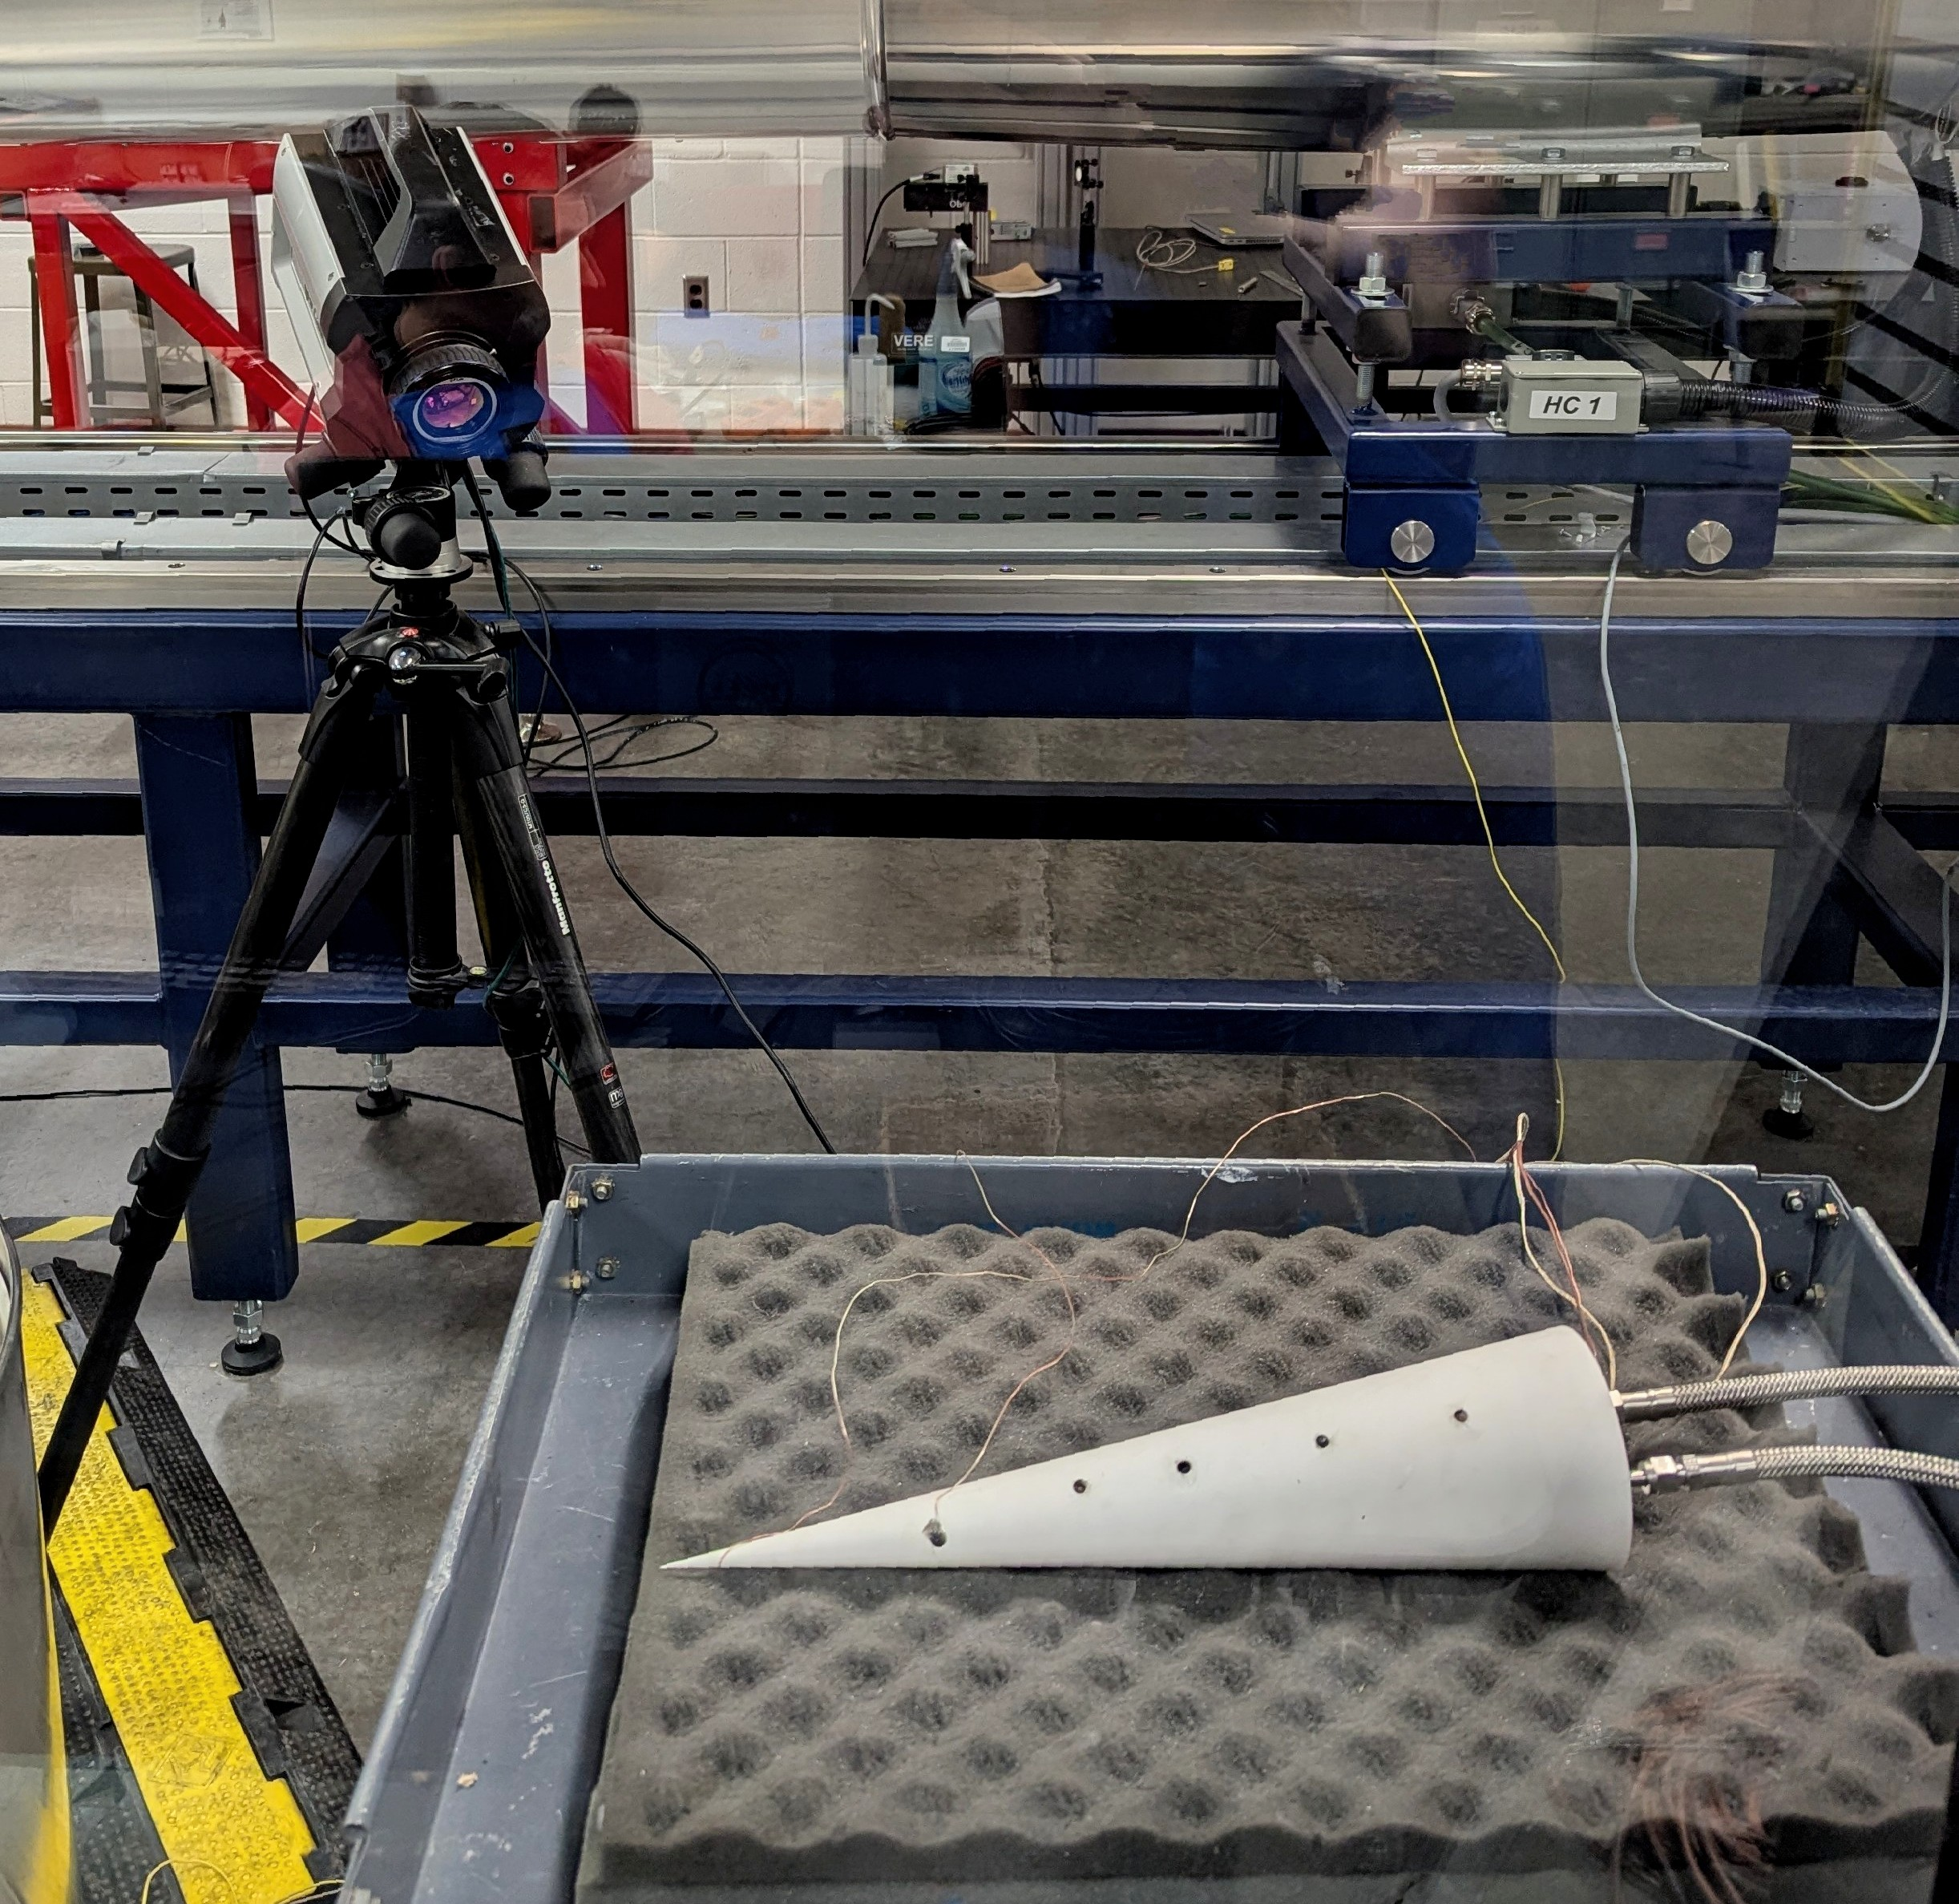
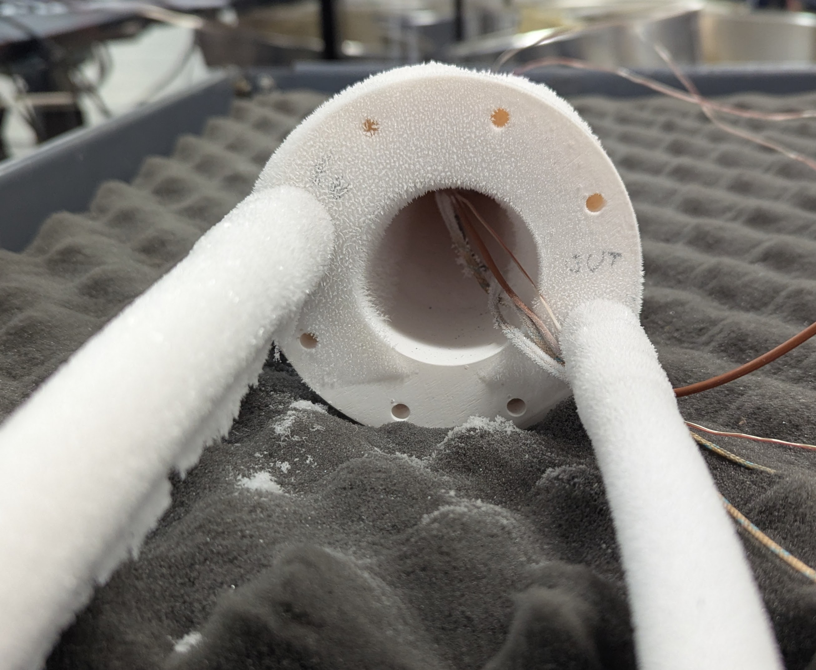
Bench Testing
6 thermocouples secured to model surface with cryogenic epoxy
Infrared camera pointed at model during test
~65 minute test duration
LN2 evaporation
Fig 11: Model Inlet & Outlet Developing Frost During Test
Fig 12: Camera & Cone Set Up During Test

Slide 8
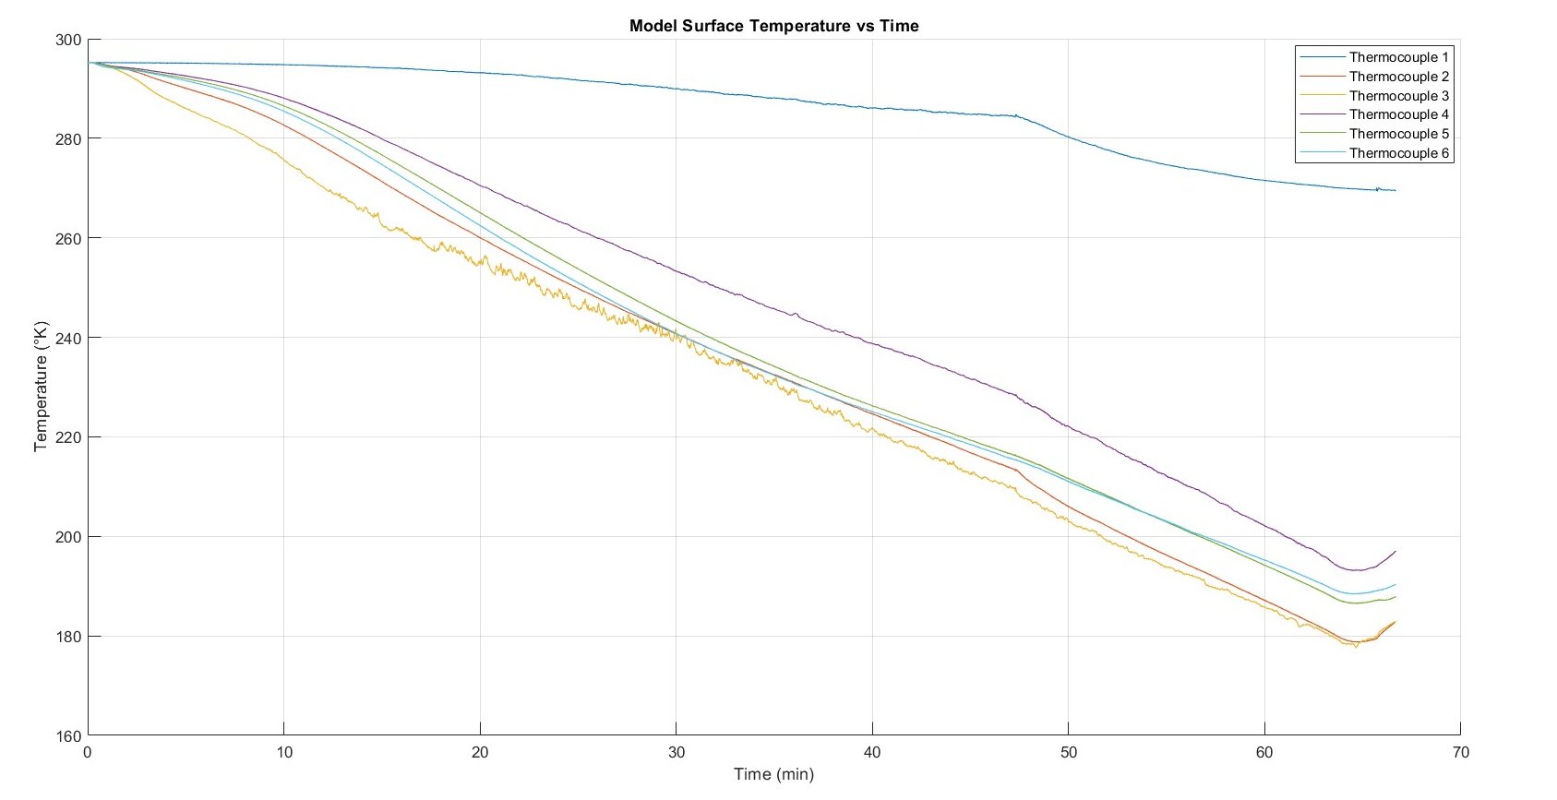
Thermocouple Transient Results

Slide 9
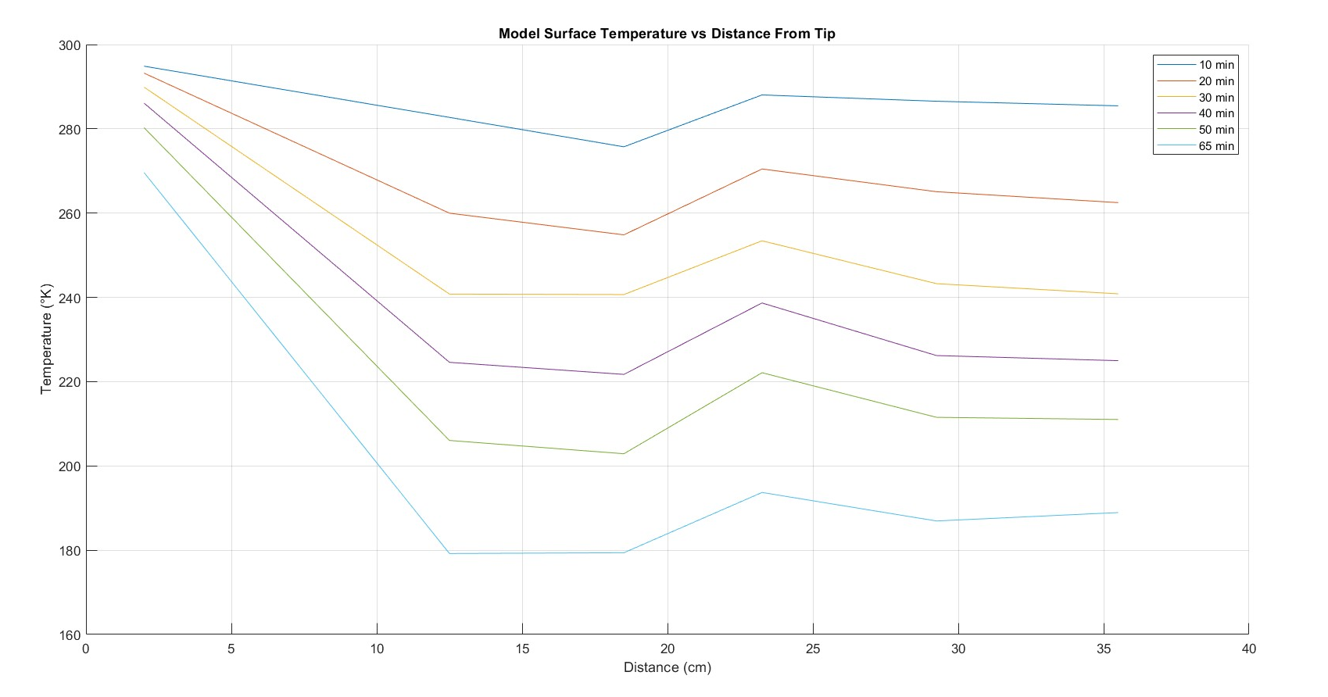
Thermocouple Spatial Results

Slide 10
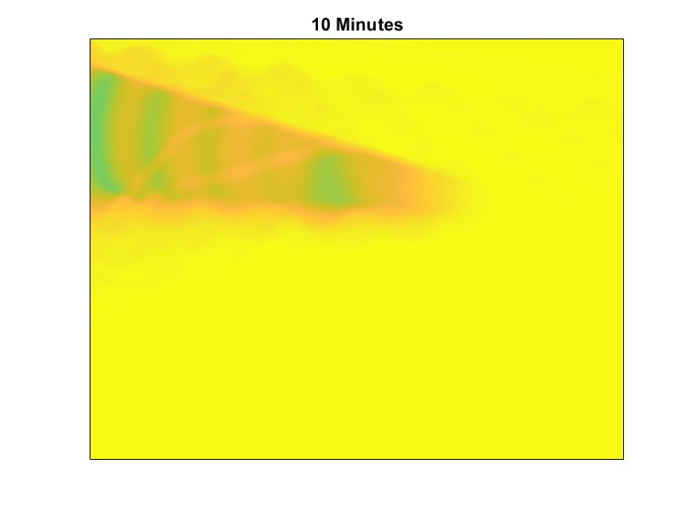
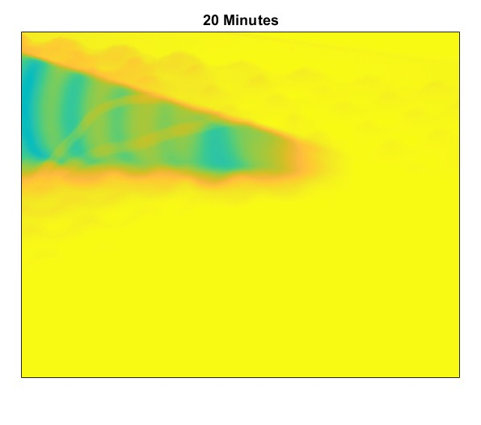
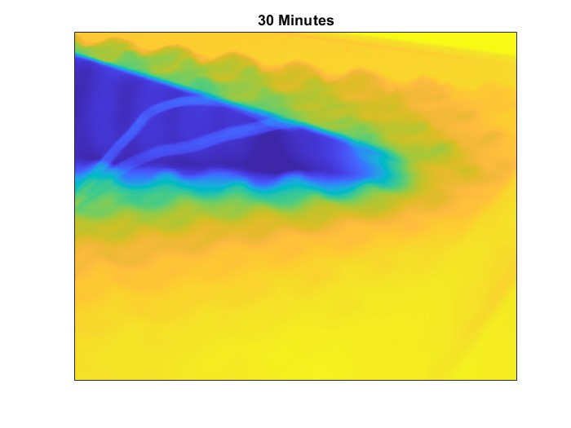
Infrared Images
Color scale not defined due to calibration challenges at cryogenic temperatures

Slide 11
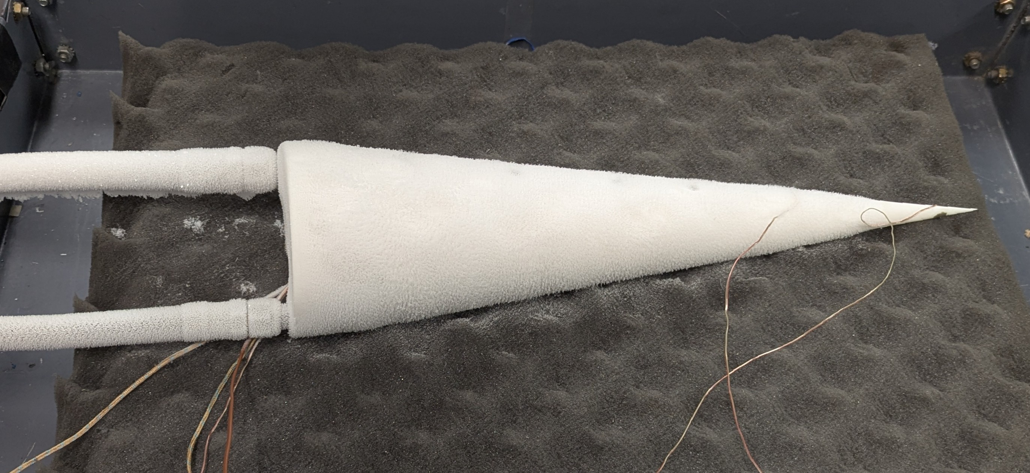
Conclusions
LN2 through internal coiled channels is an effective method for cooling a cone model over a long period of cooling time
Fig 13: Cooled Model
Future Work
Longer bench test with larger amount of initial LN2
IR data calibration & refinement
Model tip of alternative material(s) for more uniform cooling
Pumping system installation in LT5 & frost management

Slide 12
Acknowledgments
NASA Space Grant
Mentors Dr. Alex Craig & Brain Kinsey
Graduate students Adam Skora, Jackson Barger, & Emily Groth
The BLST lab

Slide 13
Thank you

Slide 14
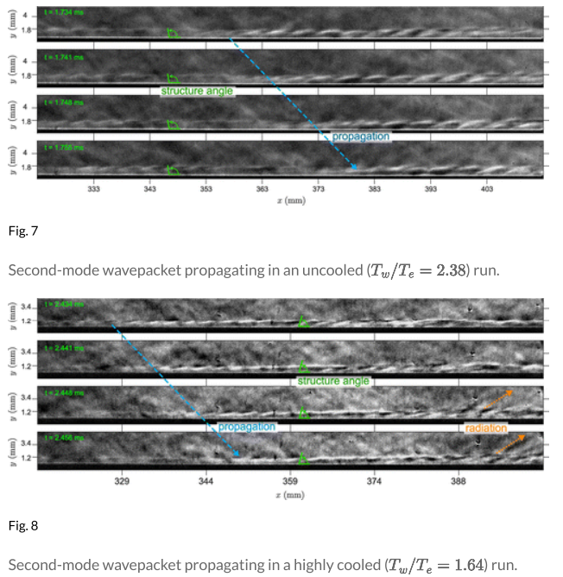
Supplemental Slide: Previous Research
Strength validation test of rigid 10K sample in dry ice bath
Cone model cooling attempt with chilled ethanol & challenges with vapor pressure
Second mode seen closer to model tip in supplemental figure
Supplemental figure, Paquin et al. (2022)

